Slide 1

Interim Capstone Presentation
Project Title: “The Impact of Generative AI on Enterprise Workforces”
Batch: Post Graduate Program in Data Science (GenAI Specialization)
Team Members: B. Sai Tejaswini, Shivam Dhar, Yash N, Darshan M Goswami, Keerthi Shetty
Mentor: Vibha Santhanam
Group No: 2

Slide 2
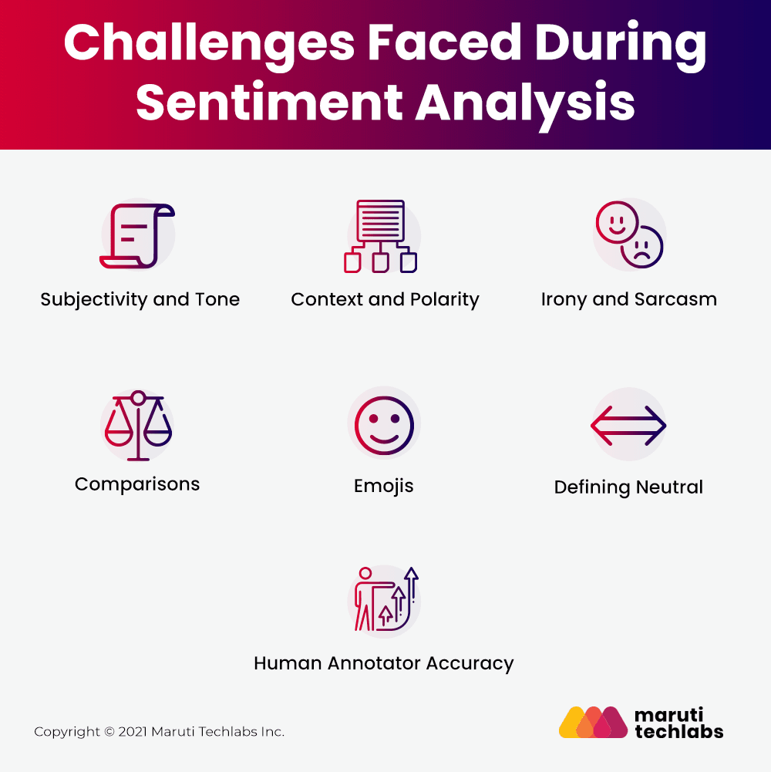
Problem Definition
Business Problem: Impact of Generative AI (GenAI) adoption on workforce productivity, job roles, and employee sentiment remains unclear.
Impact: Provides organizations with actionable insights to guide HR strategy and AI adoption.
Key Challenges:
- Capturing both structured metrics and unstructured sentiment.
- Handling class imbalance in sentiment categories.
- Ensuring interpretability of predictions.

Slide 3
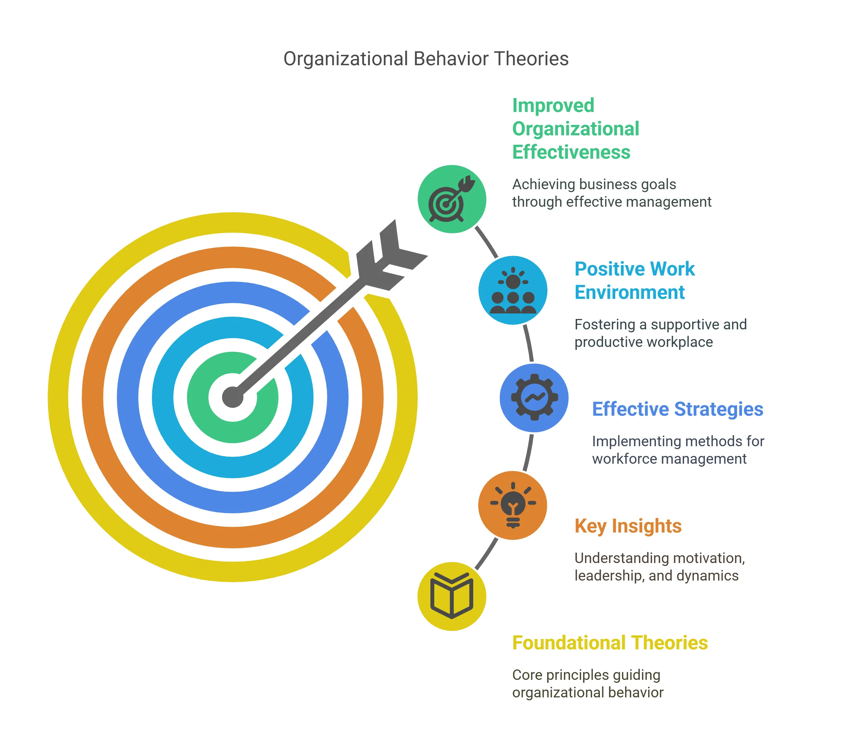
Project Justification
Commercial Value: Helps organizations balance productivity gains with employee well-being.
Strategic Insight: Provides HR teams data-driven visibility into GenAI’s impact on employees.
Academic & Social Value: Advances research on workforce transformation, AI adoption, and employee sentiment.

Slide 4
Dataset Overview
Source: Kaggle – Enterprise GenAI Adoption & Workforce Impact Dataset (~100K rows, 10 columns).
Features:
- Company, Industry, Country, GenAI Tool.
- Adoption Year, Employees Impacted, New Roles, Training Hours.
- Productivity Change (%).
- Employee Sentiment (text).
Target Variables:
- Sentiment Classification → Positive / Neutral / Negative.
- Productivity Impact → Low / Medium / High.

Slide 5
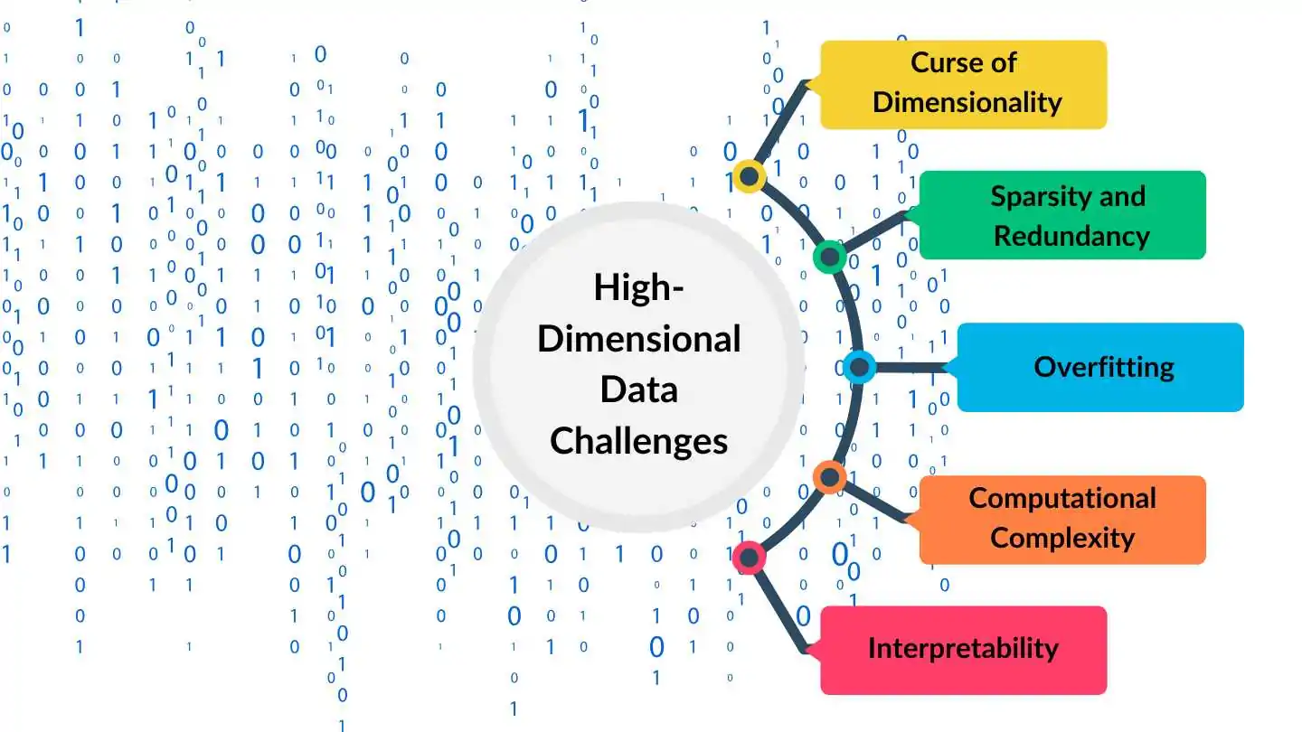
Data Dictionary & Variable Categorization
Categorical (5): Company, Industry, Country, GenAI Tool, Employee Sentiment.
Numerical (5): Adoption Year, Employees Impacted, New Roles, Training Hours, Productivity Change (%).
Issues Identified:
- High dimensionality in text data.
- Imbalanced sentiment classes.

Slide 6
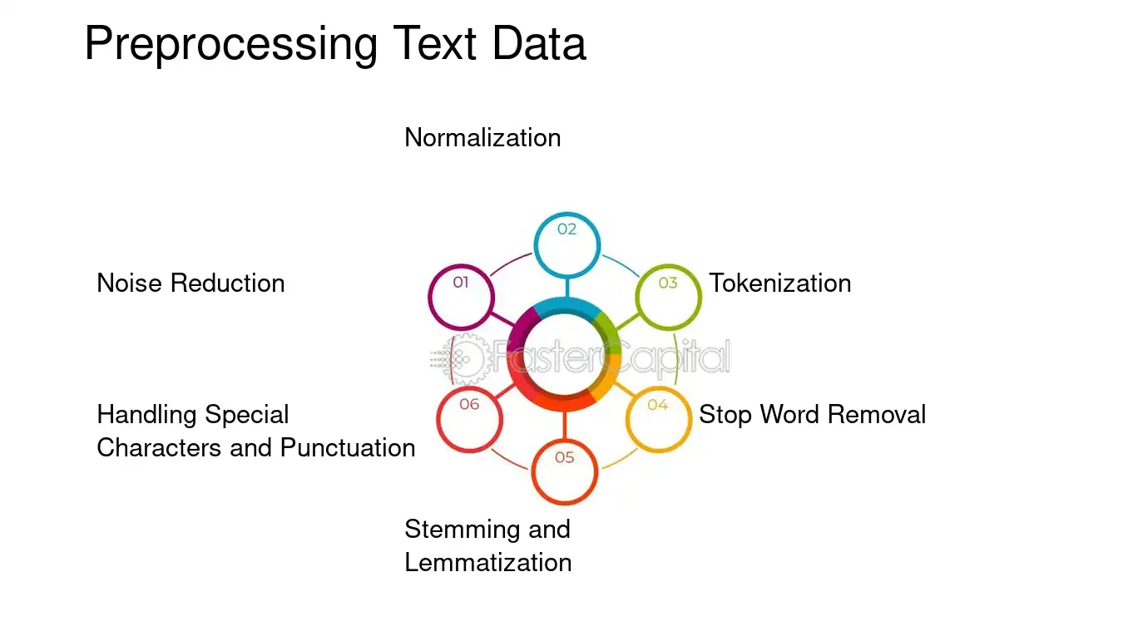
Data Preprocessing
Missing Values: None (100% complete dataset).
Encoding: Label Encoding for categorical, TF-IDF for sentiment text.
Scaling: StandardScaler for numeric features.
Text Processing: Tokenization, stopword removal, sentiment polarity scoring.
Feature Engineering: Combined structured + textual features for modeling.

Slide 7
EDA Highlights
Adoption Trends:
- Years range from 2022–2024 (peak in 2023).
Workforce Impact:
- Employees impacted range 100–20,000.
- Average productivity change ~15–20%.
Sentiment Distribution:
- Positive ~23%, Neutral ~54%, Negative ~23%.
Correlations:
- Training Hours ↔ Productivity Change.
- New Roles Created ↔ Employee Sentiment (positive shift).

Slide 8
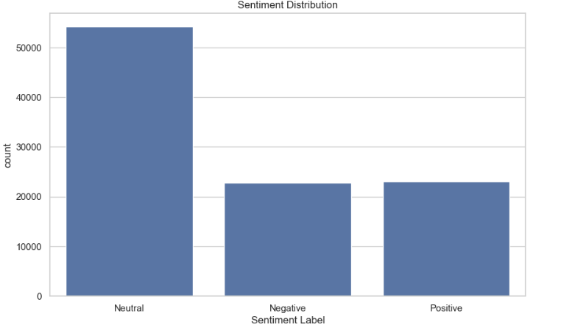
EDA Highlights
Sentiment Distribution:- Positive ~23% , Neutral ~54% , Negative ~23%.

Slide 9
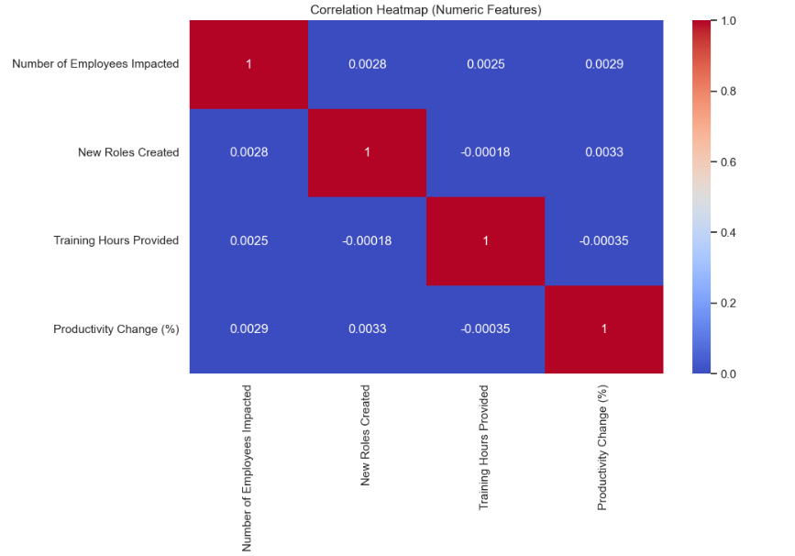
EDA Highlights(Correlation)
Correlations:
- Training Hours ↔ Productivity Change.
Numeric predictors do not directly correlate linearly with productivity change.
However — low correlation ≠ no relationship

Slide 10
Proposed Models
Classification (Sentiment & Productivity Buckets):
- Logistic Regression (baseline)
- Random Forest, Decision Tree
- Gradient Boosting / XGBoost
Text Analysis (Sentiment):
- VADER / TextBlob (lexicon-based)
- TF-IDF + ML classifiers
Regression (optional):
- Predicting actual productivity % change

Slide 11
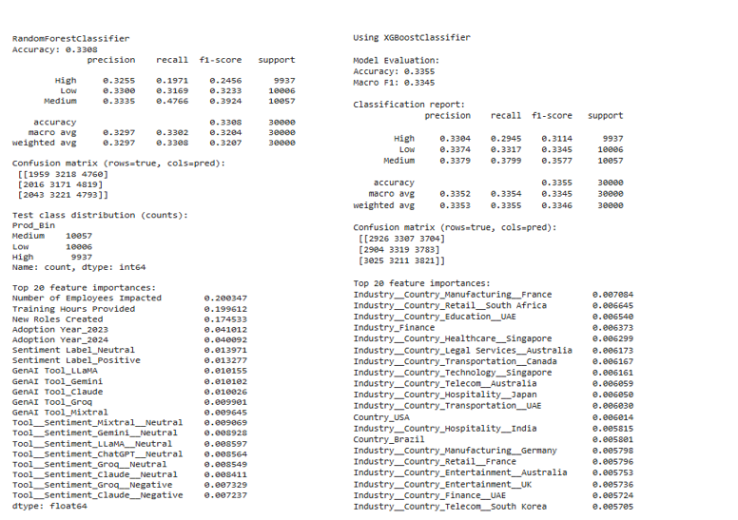
Proposed Models

Slide 12
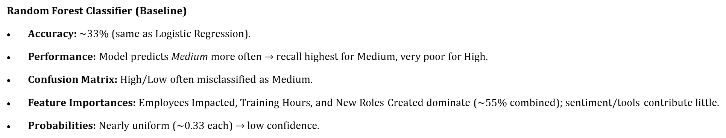
Proposed Models

Slide 13
Proposed Models

Slide 14
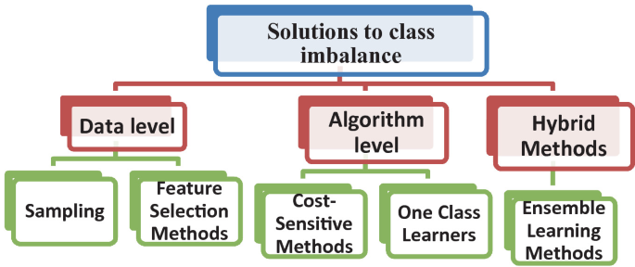
Challenges & Mitigation
Very low predictive performance in 3-class productivity models (~33% accuracy, near random).
Bias toward “Medium” class → High & Low productivity cases misclassified.
Weak signal from structured features (Training Hours ↔ Productivity ≈ no correlation).Noisy / short employee feedback text → limited NLP value.
Overlap & imbalance across productivity and sentiment classes.

Slide 15
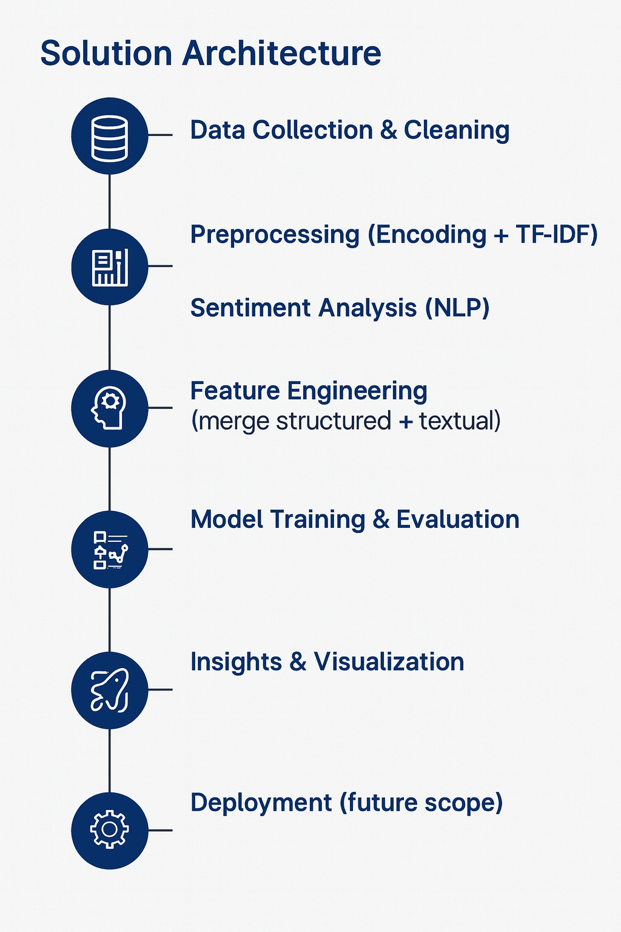
Solution Architecture

Slide 16
Expected Outcomes
- Predict productivity impact (Low/Medium/High).
- Predict employee sentiment(Positive/Negative/Neutral).
- Identify key factors driving productivity change.
- Provide organizations with insights to shape HR and AI adoption strategies.
- Create foundation for future workforce analytics solutions.

Slide 17

Thank You

